Slide 1
Weather Water Project
By: Bryan Pham, Caleb Ponce

Slide 2
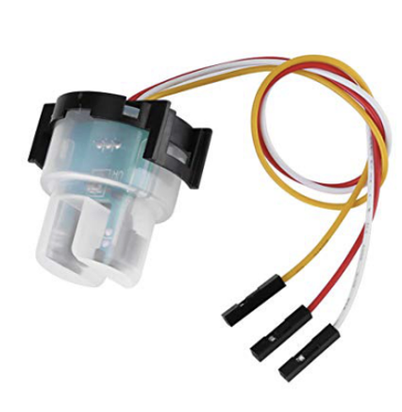
Sensor 1: Turbidity
Turbidity is caused by particles suspended or dissolved in water that scatter light making the water appear cloudy or murky.
Unit conversion formula:
Turbidity (NTU) = - 1120.4 (Voltage (mV)^2) + 5742.3(Voltage(mv)) – 4352.9

Slide 3
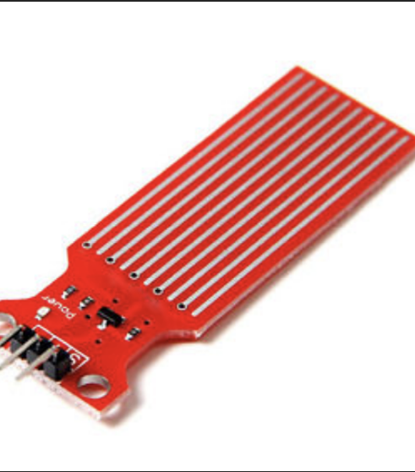
Sensor 2: Salinity
Salinity is the concentrations of salts in water.

Slide 4
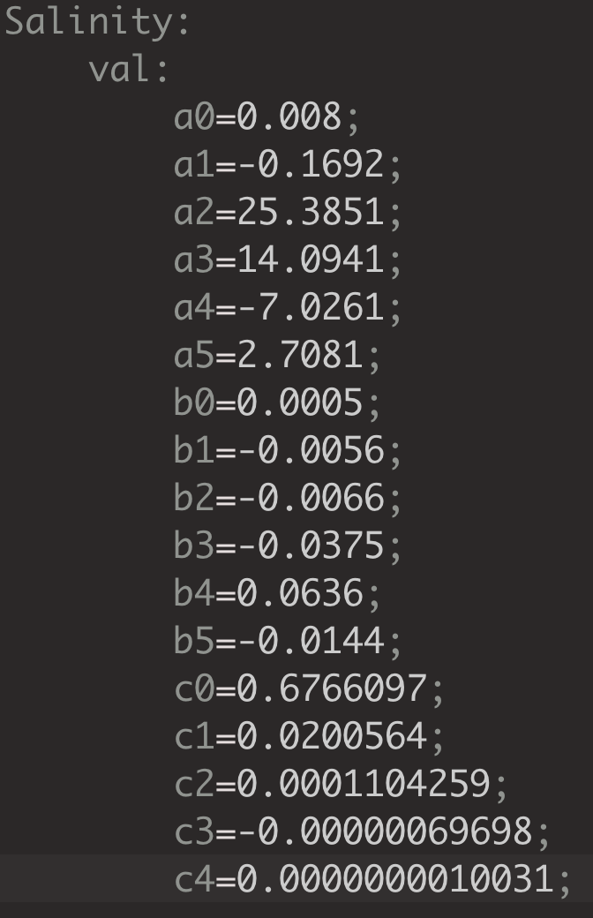
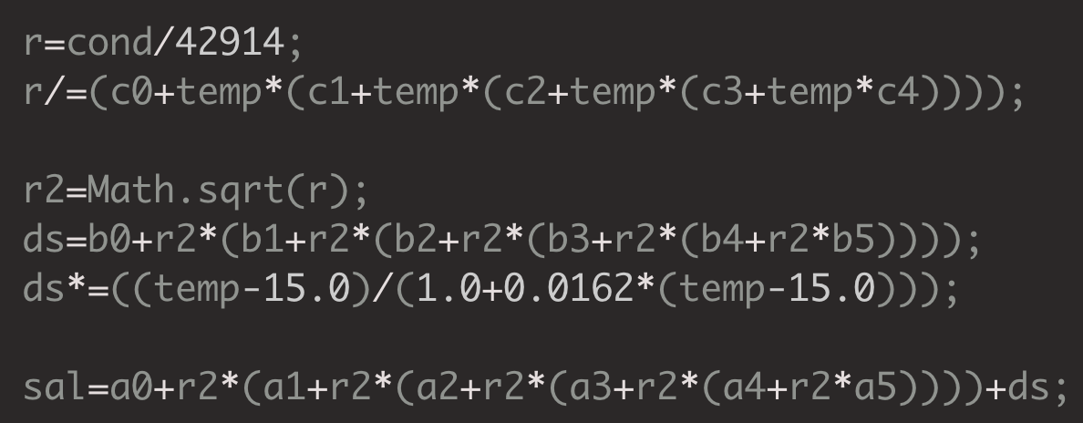
Sensor 2: Salinity
Unit conversion formula:

Slide 5
Next Step: Testing
I will be running test for each of the sensor I just program and all the existing sensor as well to make sure all the sensor works and that we have all the documentation of the tests.

